Slide 1
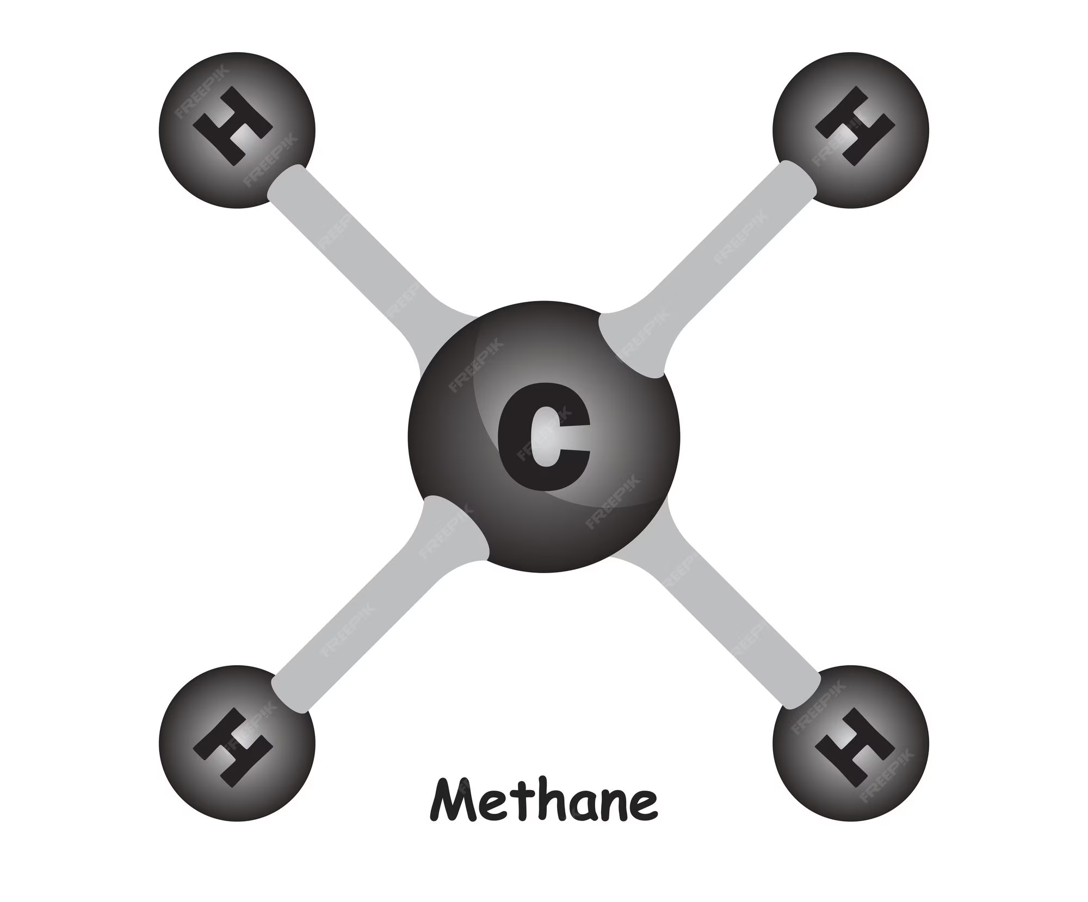
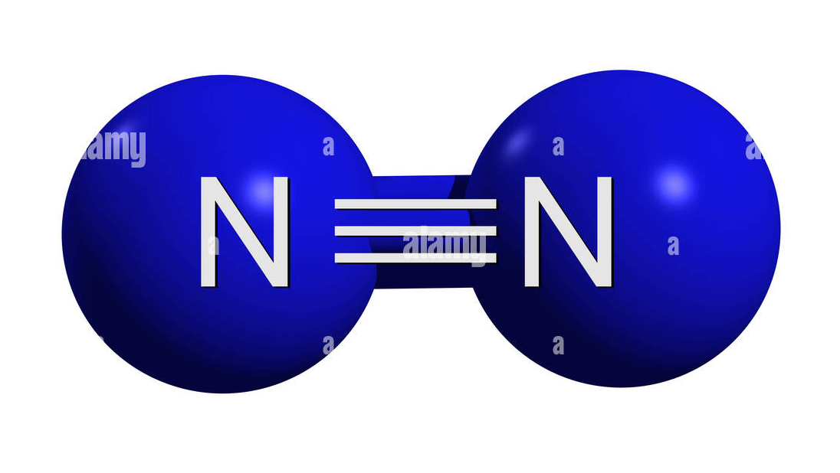
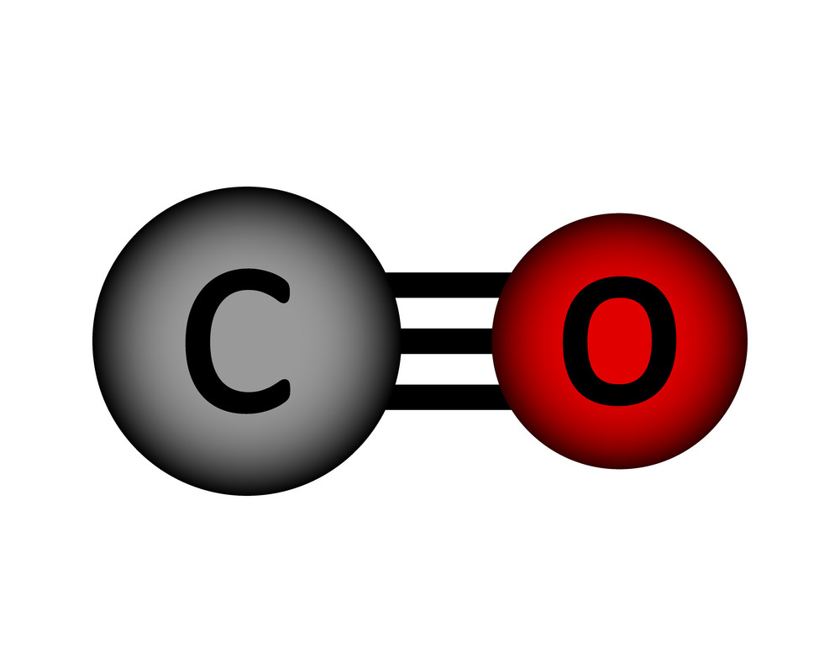
Solid State Diffusion of Common Volatiles in the Solar System
Trisha Lucas
Notes:
(1 slide/minute) get my story straight: Implications for pluto, how we are running the experiment, how we are interpreting everything, what we think is happening at the molecular level

Slide 2
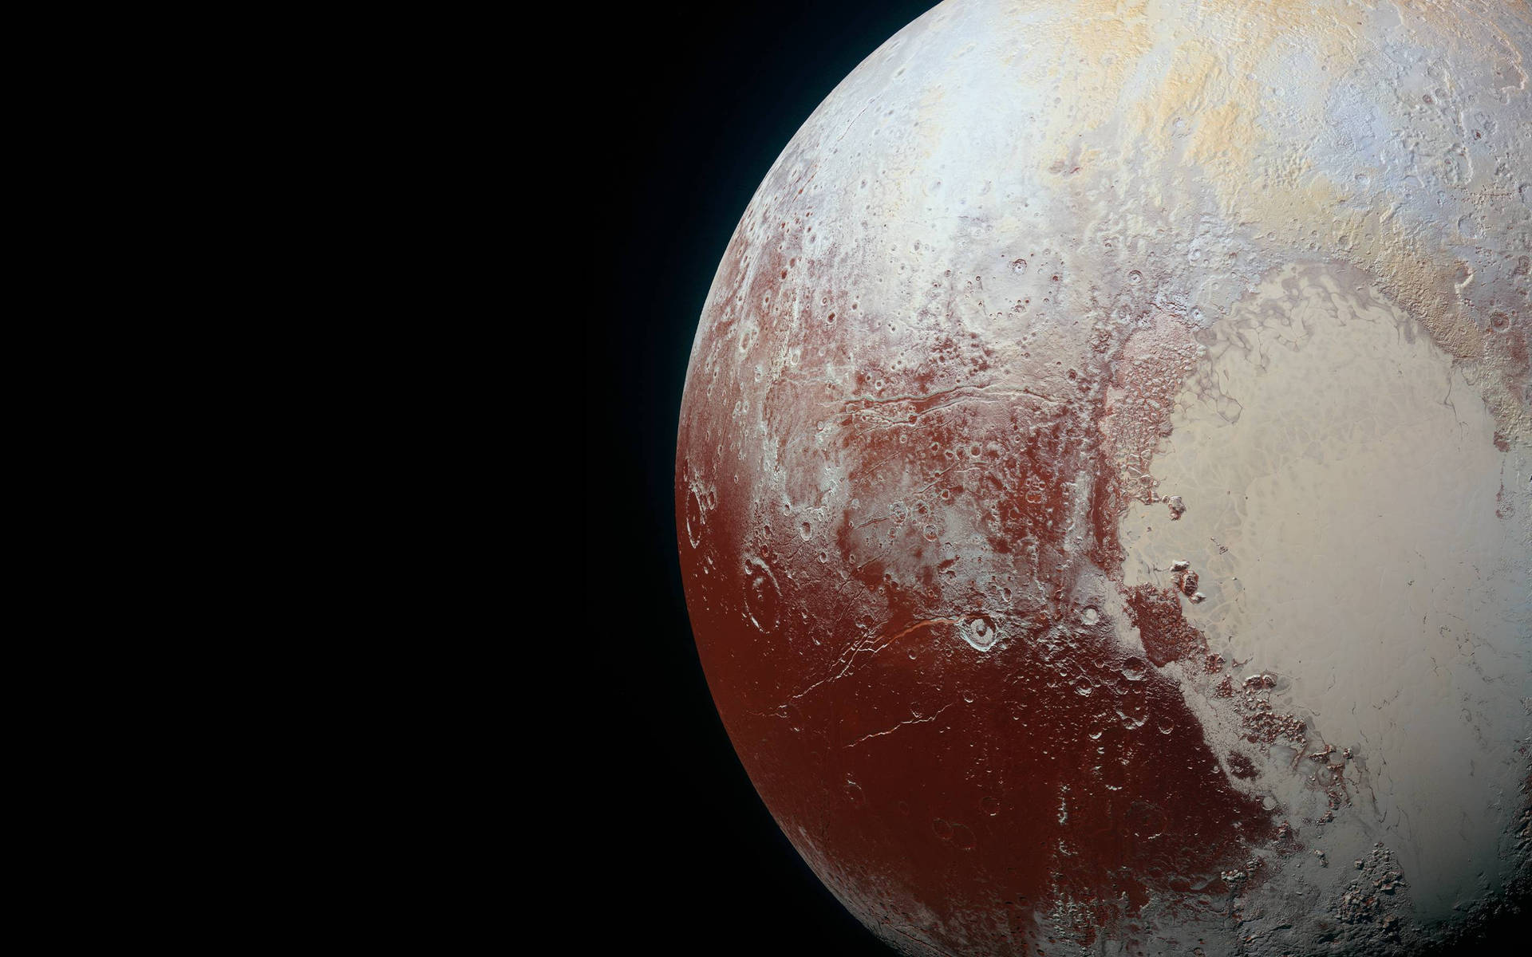
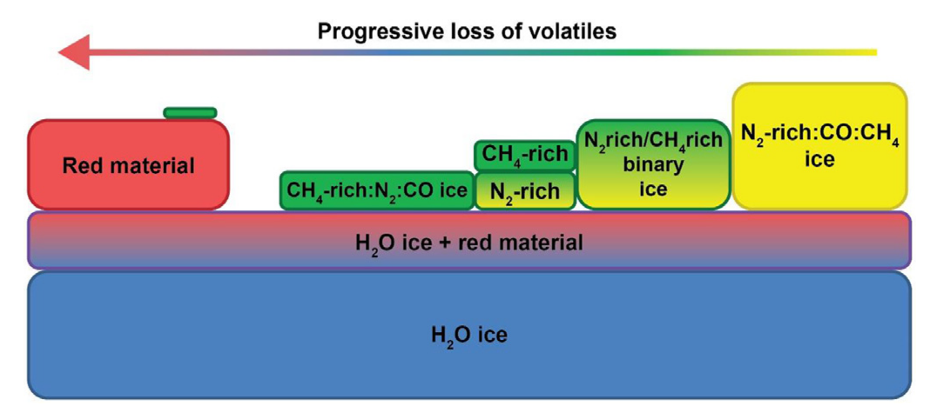
Applications:
Icy bodies
How exactly are volatiles around Pluto transporting and affecting the surface and atmosphere?

Slide 3
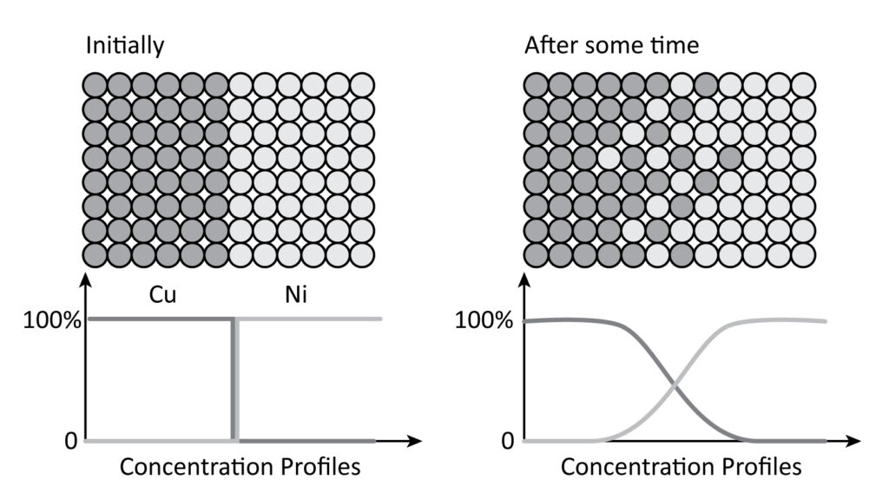
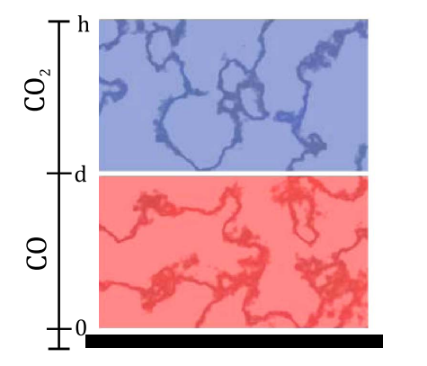
Ideal Fickian Diffusion:
Diffusion in the lab:
C₂H₆
Laying down a less volatile species on top of a more volatile species
N₂

Slide 4
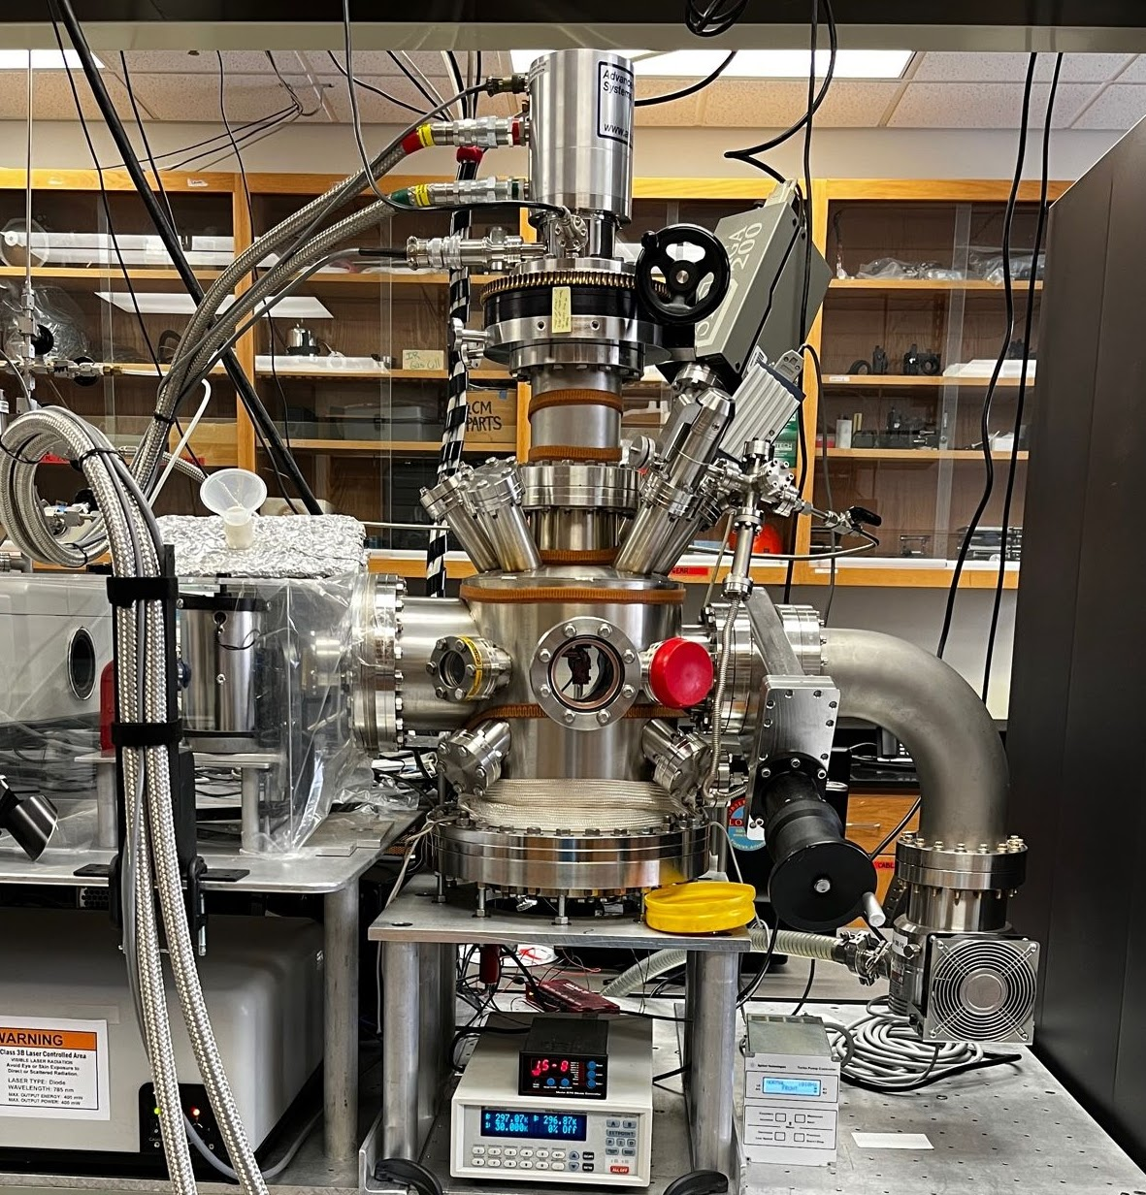
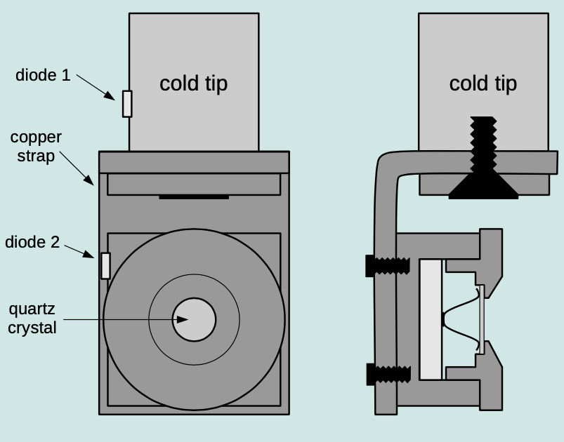
Ice Lab Instrumentation

Slide 5
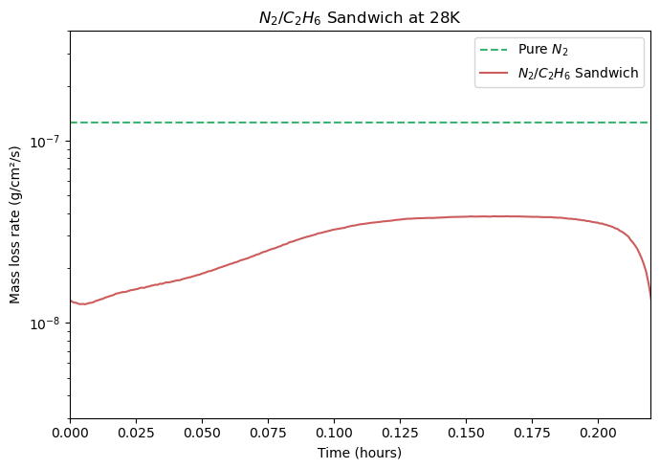
Fig. 1. Sublimation loss of N₂ ice after diffusing through a less volatile ethane ice cap

Slide 6
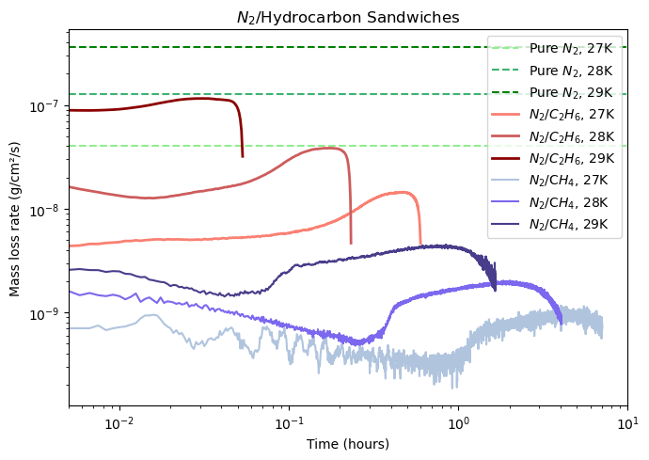
Fig. 2. Sublimation loss of N₂ ice after diffusing through a hydrocarbon ice cap at different temperatures

Slide 7
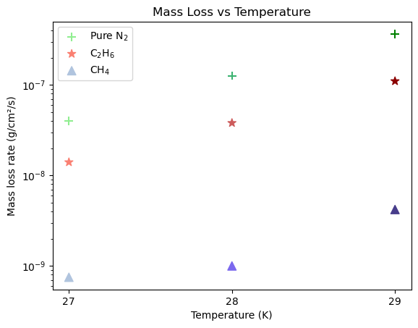
Fig. 3. Highest constant mass loss plotted against temperature

Slide 8
Conclusion
We can measure the escape of one volatile species through a less volatile species in the lab
Has it been doing what we expect? Of course not!
Why is it so different from species to species and what are the actual mechanics of what is going on?
Notes:
Less diffusion and more pore flow?

Slide 9
Thanks!
Questions?

